Slide 1
WHAT IS HTML & CSS ?

Slide 2
WHAT IS HTML?
HYPER TEXT MARKUP LANGUAGE.
markup language - A markup language is computer language that uses tags to define elements.
It is used to create web pages.

Slide 3
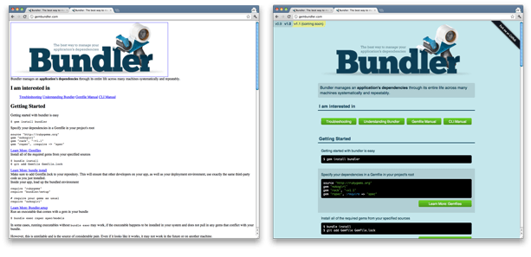
WHAT IS CSS?
Cascading Style Sheet.It is used to style HTML pages.

Slide 4
HTML STRUCTURE
Heading
Simple Text(Paragraph)
Image
Line
Website links
Table
Login/Signup forms
This all can be done using tags in html.

Slide 5
CSS Basics
Text color
Background color
Text alignment
Border
..............

